Slide 1
House Prices Prediction
DR / Engy Elshafeey Eng / Gomaa ElMokhtar

Slide 2
Team members
01
04
02
03
Mohamed Gomaa Marshoud Ghwail
Abdelrahman Zagloul Diab Mohamed
Ahmed Ayman Mohamed SayedAhmed Hassanin
05
Mahmoud Ashraf ELsheemy
Ahmed Ashraf Khatab
06
Mahmoud Amr Mahmoud Deasa

Slide 3
Table of contents
01
02
03
04
Project idea
Dataset
Code
Output

Slide 4
01
Project idea
(AI)

Slide 5
Project Idea: House Price Prediction Objective Create a model to predict house prices based on key factors, helping buyers, sellers, and real estate agents make informed decisions.

Slide 6
02
Dataset
(AI)

Slide 7
Dataset
Dataset was used from Kaggle website to view it, you can do so through the link
https://www.kaggle.com/datasets/yasserh/housing-prices-dataset
Description:
A simple yet challenging project, to predict the housing price based on certain factors like house area, bedrooms, furnished, nearness to mainroad, etc. The dataset is small yet, it's complexity arises due to the fact that it has strong multicollinearity. Can you overcome these obstacles & build a decent predictive model?

Slide 8
03
Code
(AI)

Slide 9
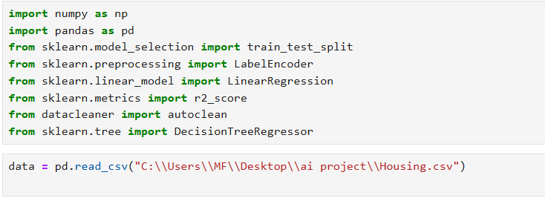
Libraries used

Slide 10
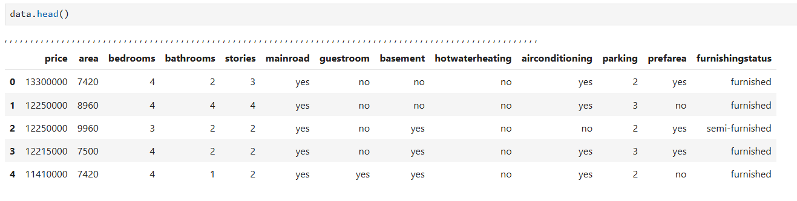
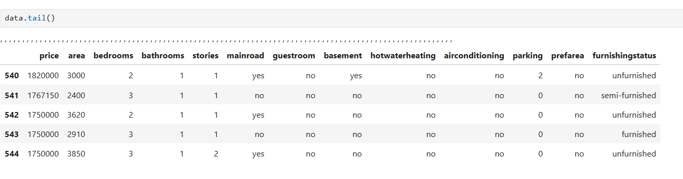
Information about dataset

Slide 11
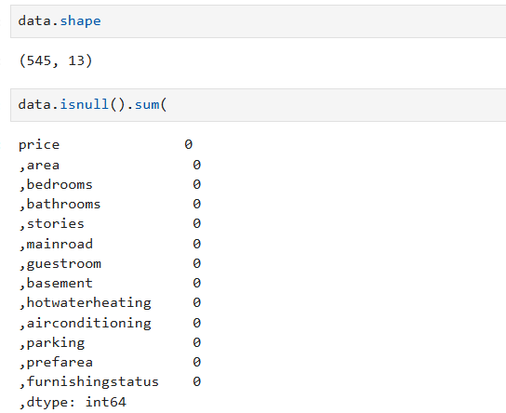
Information about dataset

Slide 12
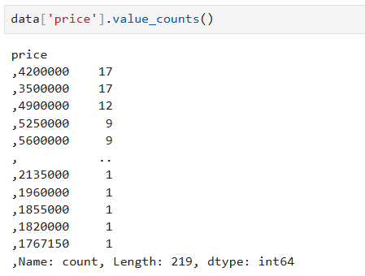
Information about dataset

Slide 13
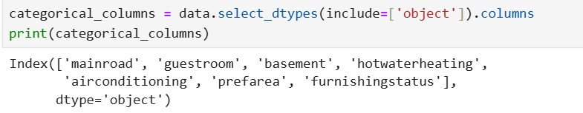
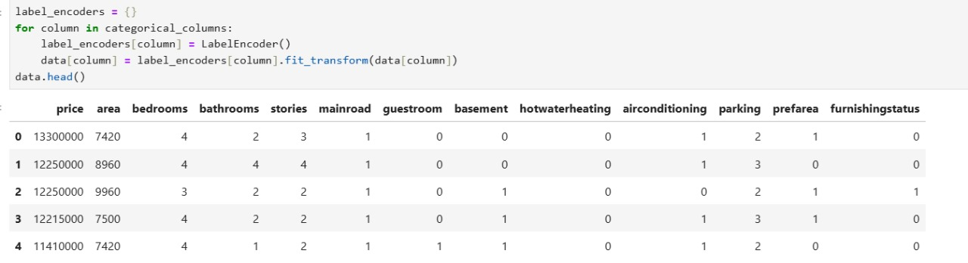
Encode & Prepare data

Slide 14

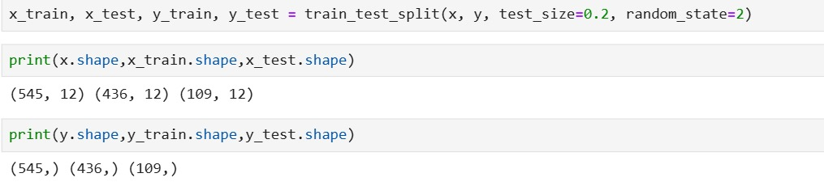
Split data

Slide 15
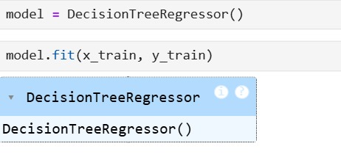
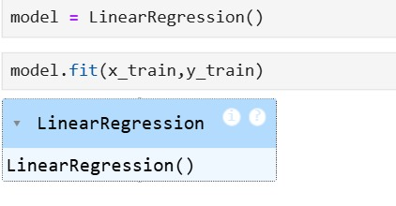
train model
Model 1 : DecisionTreeRegressor
Model 2 : LinearRegression

Slide 16
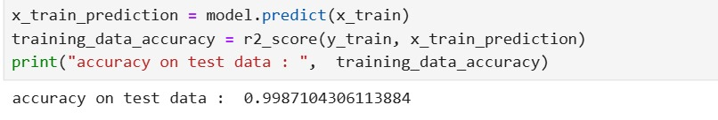
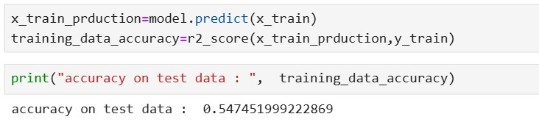
calculate accuracy
Model 1 : DecisionTreeRegressor
Model 2 : LinearRegression

Slide 17
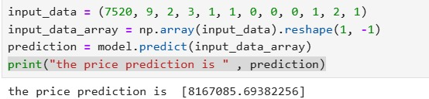
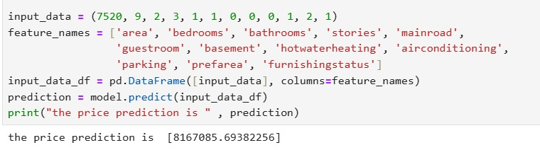
The predictive code

Slide 18
03
Output
(AI)

Slide 19
The Output

Slide 20
Thanks!

